Slide 1
Yoontaek
2012-03-26
Cuk converter analysis

Slide 2




DCVM SEPIC & CUK Converter
DCVM(Discontinuous Capacitor Voltage Mode)
  Max Input current :
  Max Input current ripple :
  Ripple per current :
  Capacitor Voltage Stress :

Slide 3
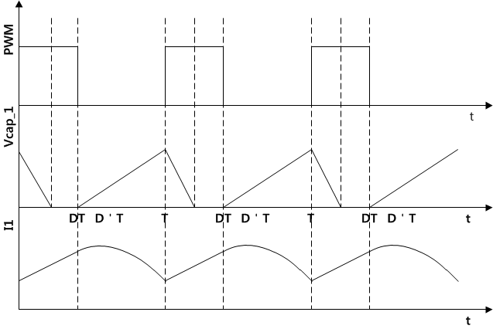


DCVM SEPIC & CUK Converter
Considering smooth input current curve
  Max Input current ripple :
  Ripple per current :

Slide 4
DCVM SEPIC & CUK Converter
According to diode-turn-off-time, input current also different =>
  Multiply about 30%
Capacitor voltage must have less than 1000V
  Always Duty < 20%

Slide 5
Idea 1 : LED Dimming
Using SEPIC(SEPIC have reverse output voltage direction of Cuk)
Idea1 is controlling LED dimming, when input voltage is fixed
  Line frequency : 60Hz
  Input voltage : 220Vrms
  Input inductor : 10mH
  Middle Capacitor : 200pF

Slide 6
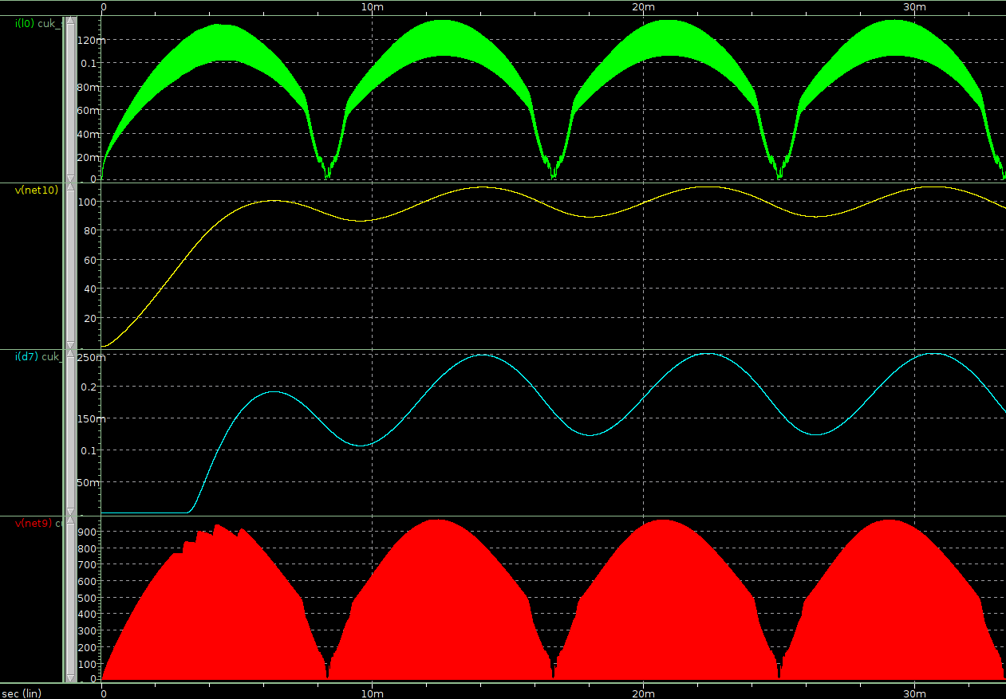
Idea 1 : LED Dimming
When input power is 20W
  T : 2.45us & Duty : 20%
    Input Power : 20.55W, Power factor : 0.9911
I_in
V_out
I_out
V_a

Slide 7
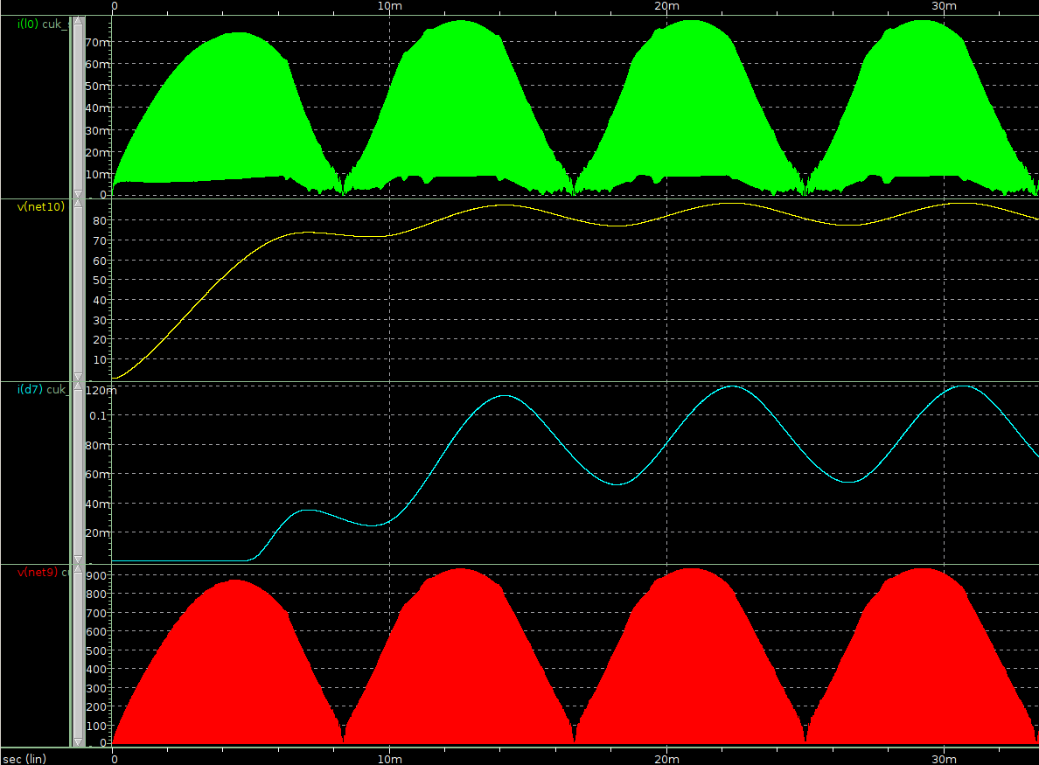
Idea 1 : LED Dimming
When input power is 10W (only control period)
  T : 4.9us & Duty : 20%
    Input Power : 8.18W, Power factor : 0.9211
I_in
V_out
I_out
V_a

Slide 8
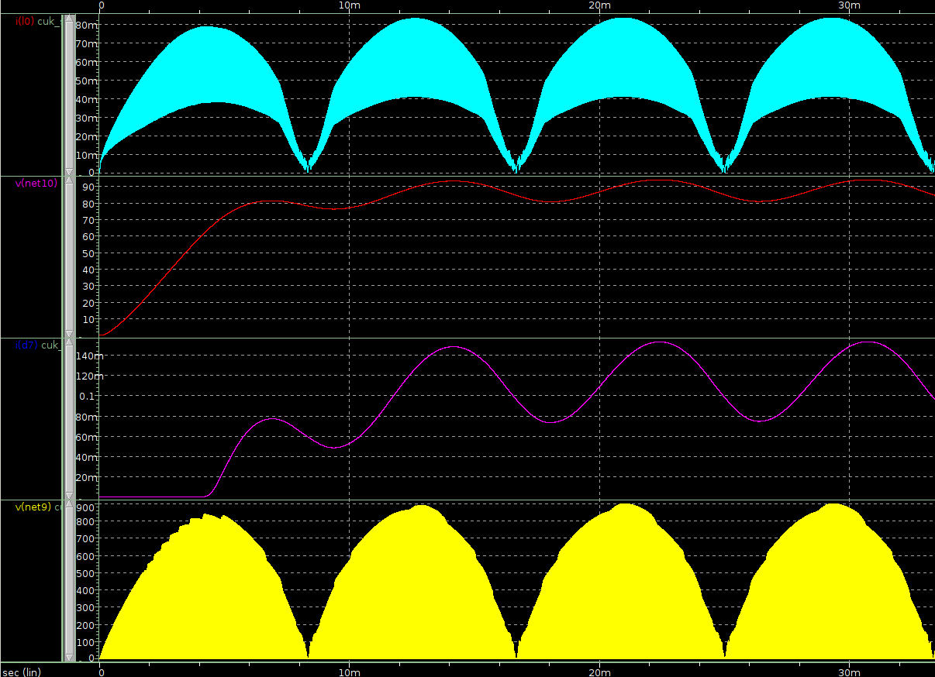
Idea 1 : LED Dimming
When input power is 10W (control period and duty)
  T : 3.9us & Duty : 10%
    Input Power : 10.1W, Power factor : 0.9697
I_in
V_out
I_out
V_a

Slide 9
Idea 2 : constant LED power
Using SEPIC(SEPIC have reverse output voltage direction of Cuk)
Idea1 is controlling LED power, when input voltage is changed
  Input voltage : 220Vrms
  Input inductor : 6.8mH
  Middle Capacitor : 400pF
  LED input power : 20W

Slide 10
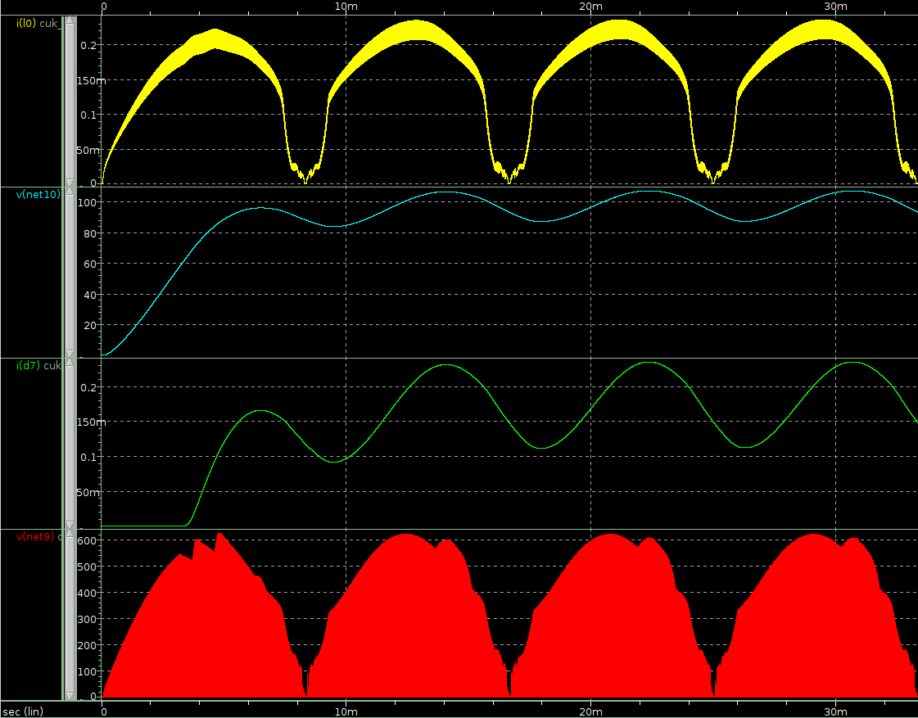
Idea 2 : constant LED power
When input voltage is 110V
  T : 2.3us & Duty : 40%
    Input Power : 19.4W, Power factor : 0.9925
I_in
V_out
I_out
V_a

Slide 11
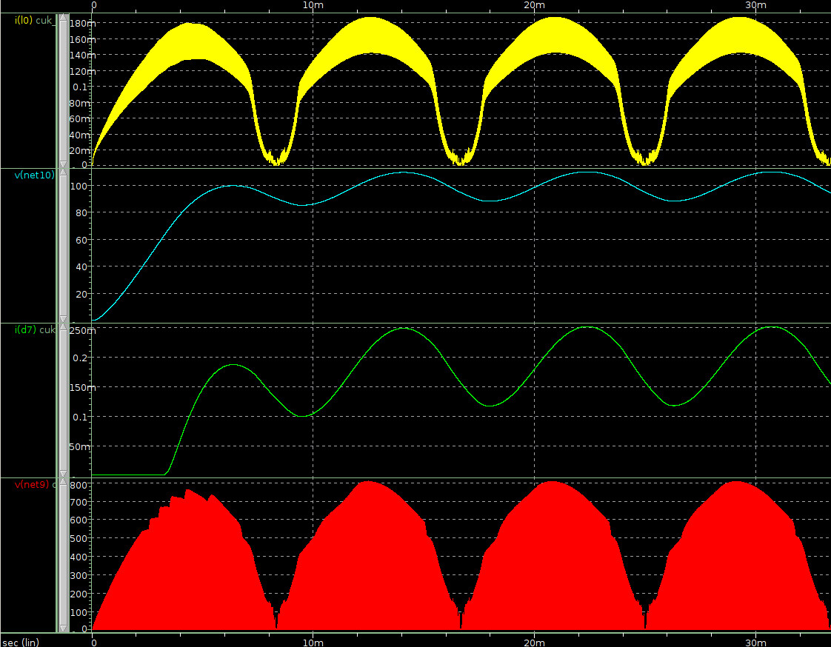
Idea 2 : constant LED power
When input voltage is 220V
  T : 3us & Duty : 30%
    Input Power : 20.84W, Power factor : 0.9922
I_in
V_out
I_out
V_a

Slide 12
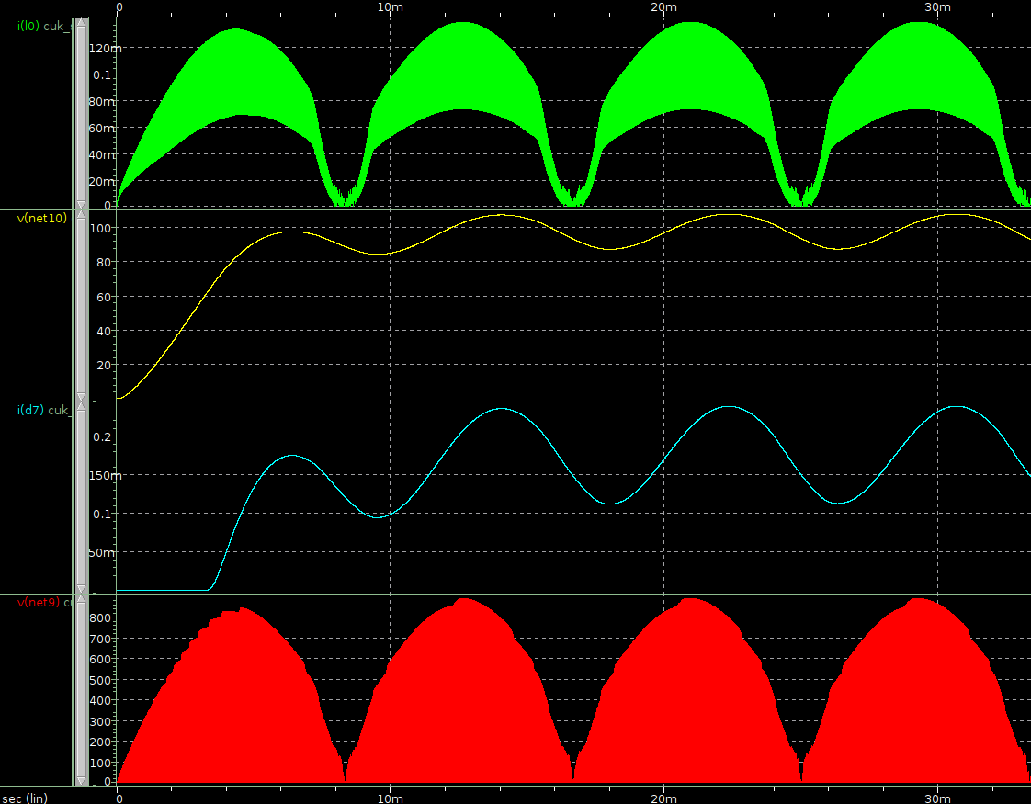
Idea 2 : constant LED power
When input voltage is 220V
  T : 3.9us & Duty : 15%
    Input Power : 19.3W, Power factor : 0.9823
I_in
V_out
I_out
V_a

