Slide 1
Yoontaek
2012-03-17
Cuk converter analysis

Slide 2
Cuk converter for LED Driver
For using LED Driver, many condition is needed. But, I focus one condition preferentially.
<Power>
For using LED Driver, this converter must have about 20W power consumption.
  Input Voltage = 315*sin(wt)V
  Power consumption = V_rms*I_rms (if, pf is almost 1)
  20W = 220*I_rms
  I_rms = 90mA
  Input current = 130*sin(wt)mA

Slide 3
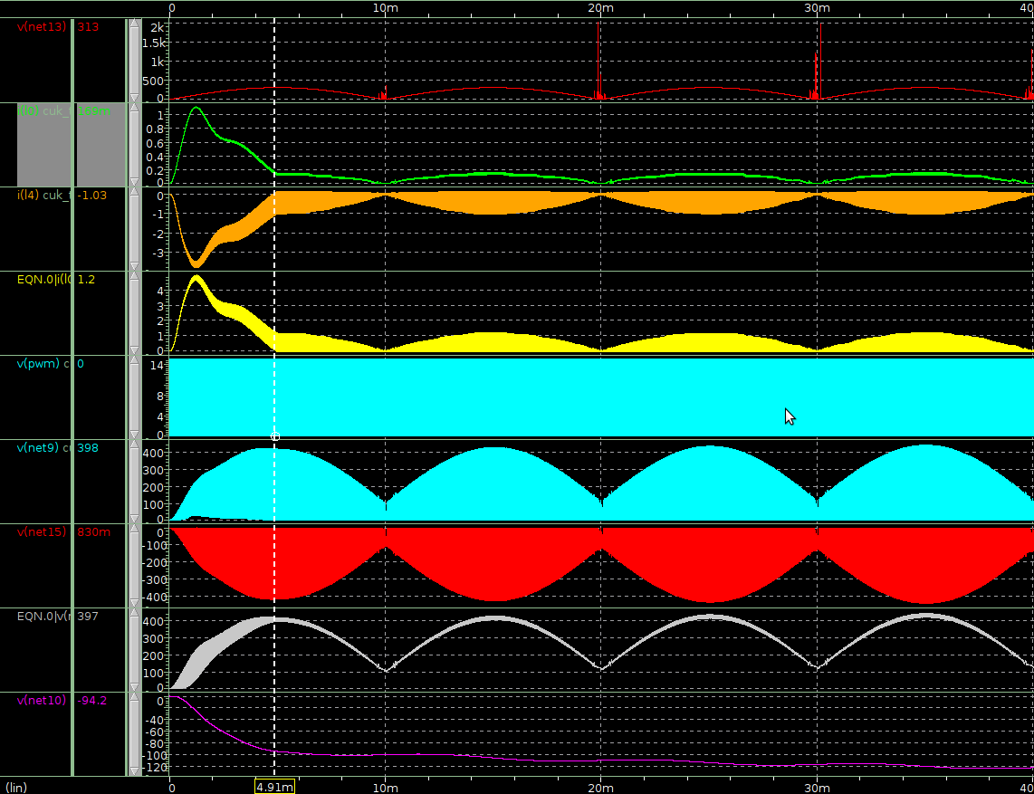
Continuous mode simulation
Vin
I_L1
I_L2
I_diode
V_pwm
V_a
V_b
V_cap
V_out

Slide 4
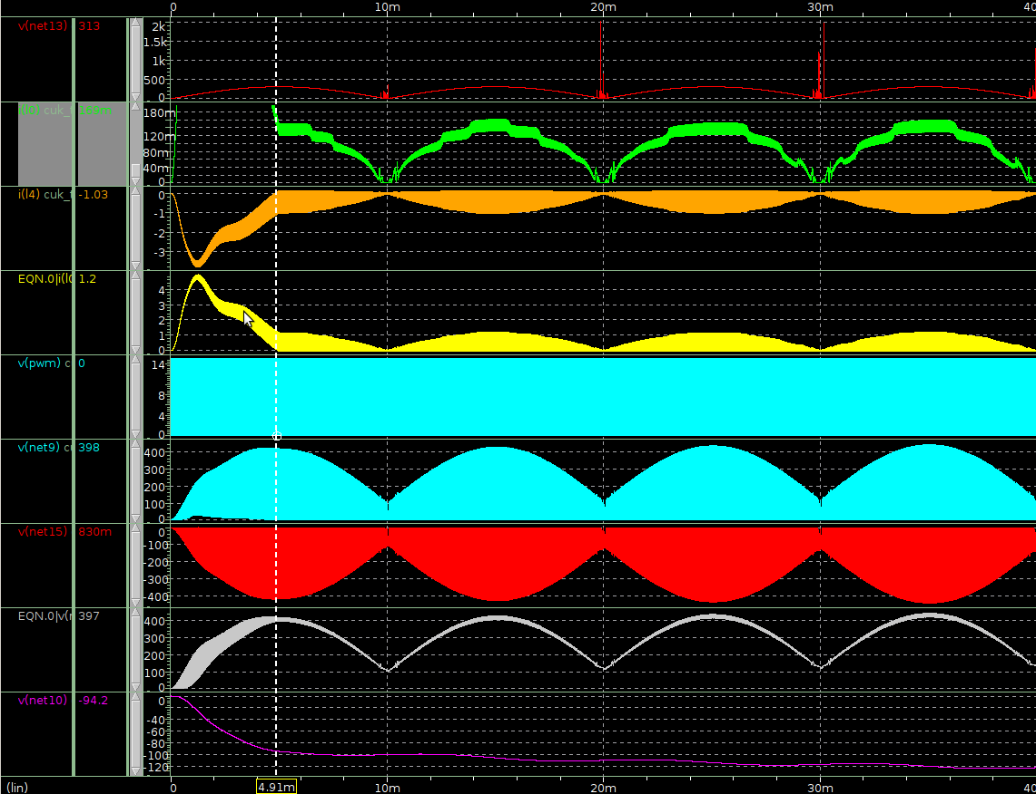
Continuous mode simulation
Vin
I_L1
I_L2
I_diode
V_pwm
V_a
V_b
V_cap
V_out

Slide 5
Causual analysis
Continuous mode operation is based on DC steady-state operation
  if input voltage is changed slowly after steady-state operation, it operate continuous by input voltage.
Output Voltage is slowly increase
  Before becoming steady-state(Vout), input current is increase rapidly

Slide 6
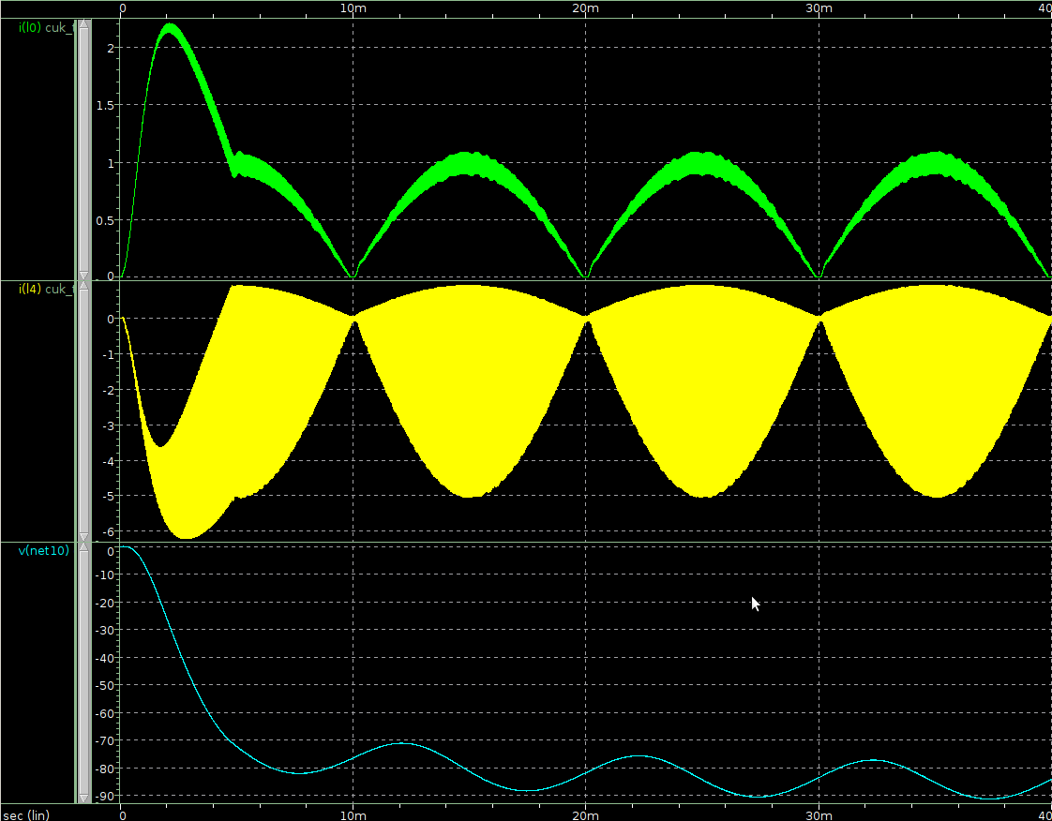
Appendix
According to the paper “The Discontinuous –”
Vin = 180
Vout=100
fs=40kHz
P=100W
Irip=20%
But generating same problem before output-voltage is floated

Slide 7
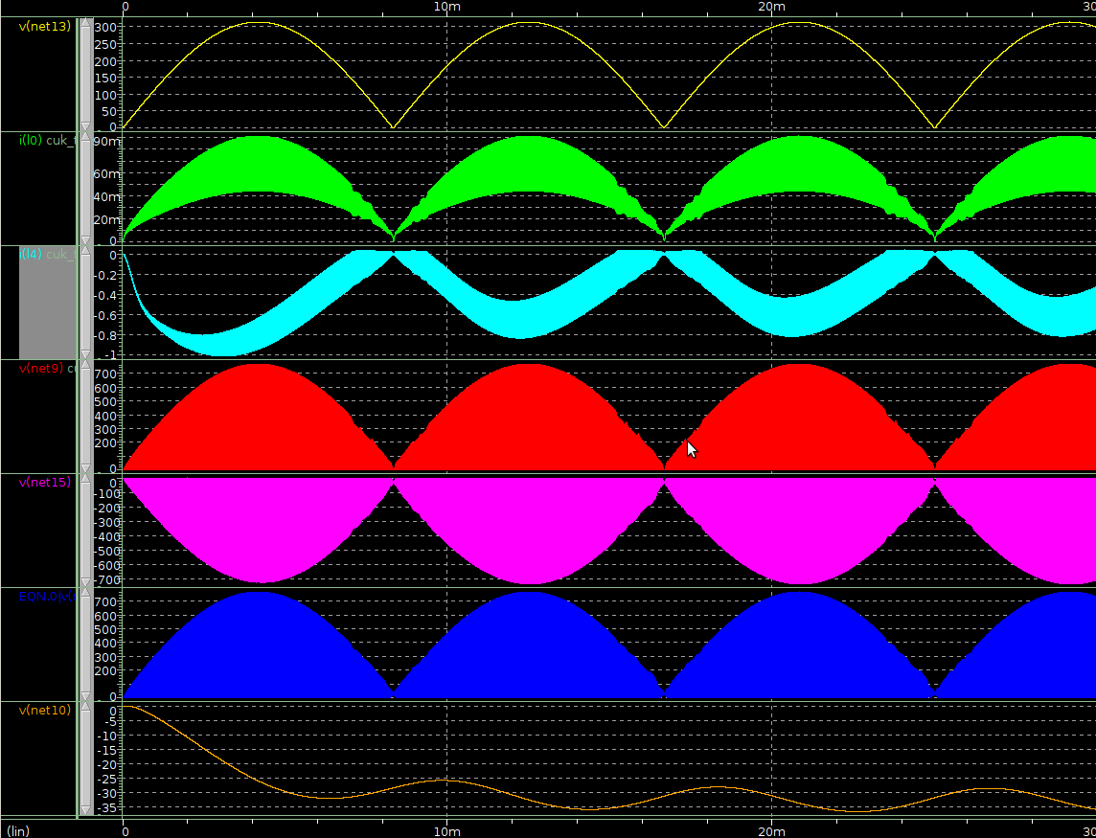
Discontinuous mode simulation
Vin
I_L1
I_L2
I_diode
V_pwm
V_a
V_b
V_cap
V_out

Slide 8




Discontinuous mode
Max Input current :
Max Input current ripple :
Ripple per current :
Capacitor Voltage Stress :
Discontinuous mode is not based on steady-state oper-.
  Input current of discontinuous mode is less dependent than continuous mode

Slide 9



Perfect continuous mode
Max Input current :
Max Input current ripple :
Ripple per current :
Capacitor Voltage Stress :

Slide 10




2.By “The discontinuous-” paper
Max Input current :
Max Input current ripple :
Ripple per current :
Prerequisite :

Slide 11
Discontinuous mode
Max Input current :
Max Input current ripple :
Ripple per current :
Capacitor Voltage Stress :
  Input current is independent of output resistor mag

Slide 12
Conclusion
For making cuk Led driver operated by DSP, I think discontinuous mode Cuk converter is appropriate.
But, that mode has expected problem.
  Input current noise generated by parasite capacitor of inductor.
  Cause is high voltage drop during very short time.

Slide 13
Necessary parts
DSP : TMS320F28335 보급형 모듈
MOSFET : IRFBG30
Capacitor : 1000V & 150pF, 220p
    250V & 10~50uF
Inductor : 10mH, 330uH (high current)
LEDs
recitifier
1000V ultra-fast diode
IC-driver : FAN7382MXCT

Slide 14
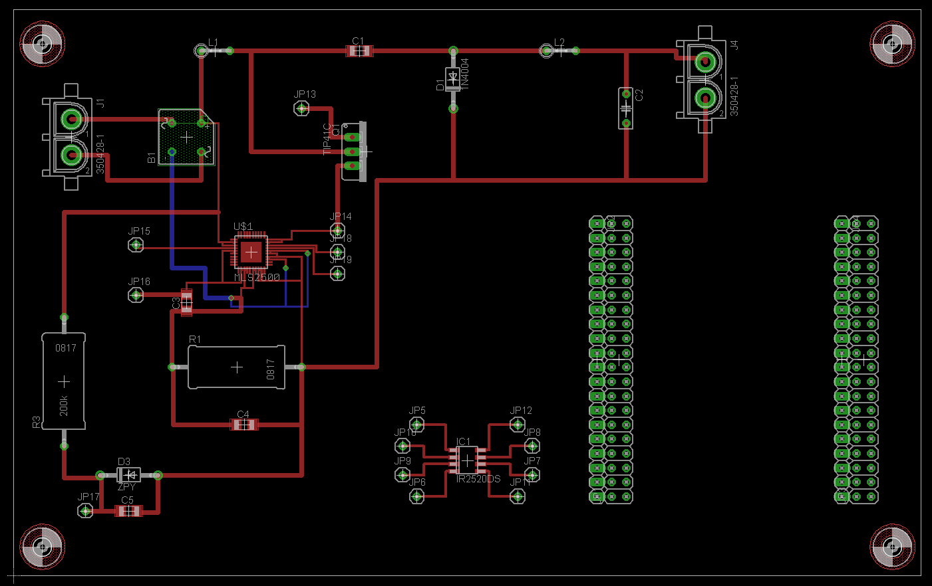
Test Board
*MLS-2500, DSP 용 Board

