Slide 1
Yoontaek
2012-03-14
Cuk converter analysis

Slide 2
Cuk converter for LED Driver
For using LED Driver, many condition is needed. But, I focus one condition preferentially.
<Power>
For using LED Driver, this converter must have about 20W power consumption.
  Input Voltage = 315*sin(wt)V
  Power consumption = V_rms*I_rms (if, pf is almost 1)
  20W = 220*I_rms
  I_rms = 90mA
  Input current = 130*sin(wt)mA

Slide 3
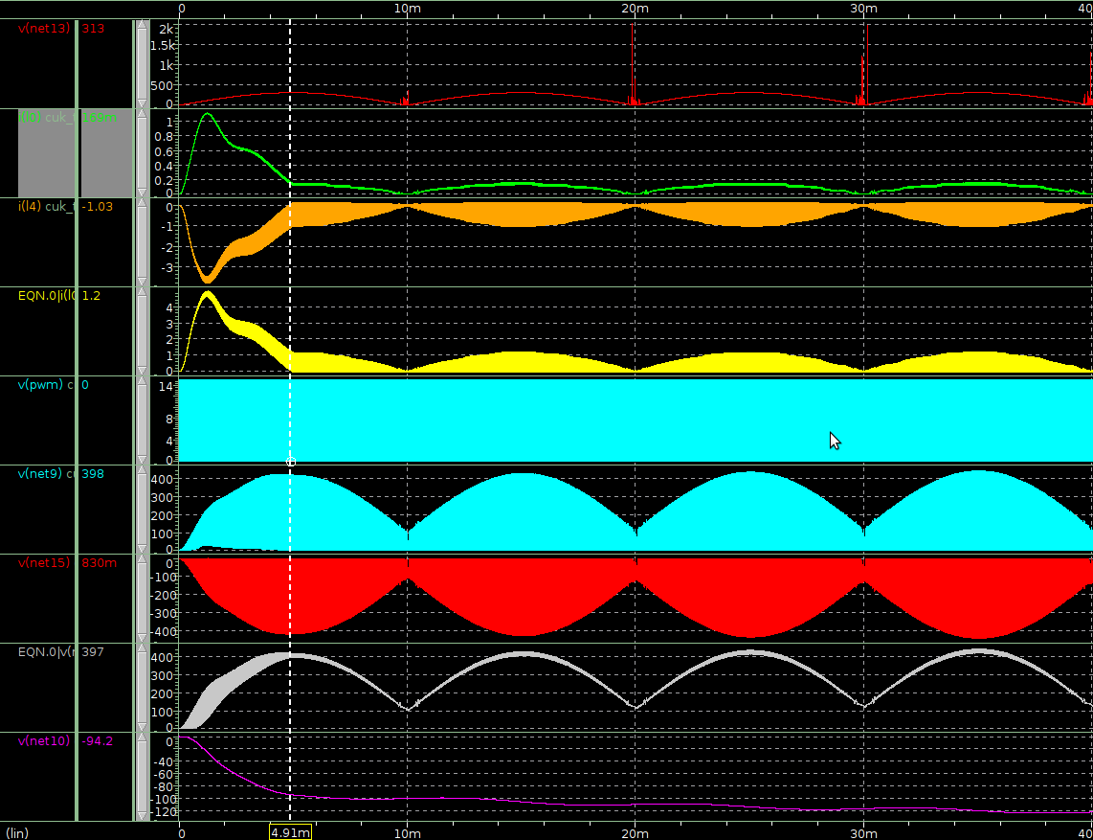
Continuous mode simulation
Vin
I_L1
I_L2
I_diode
V_pwm
V_a
V_b
V_cap
V_out

Slide 4
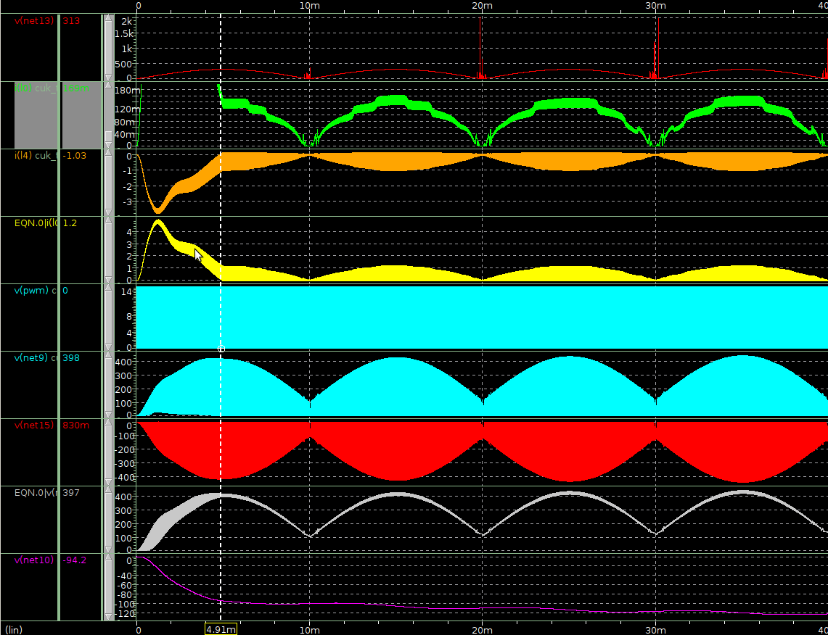
Continuous mode simulation
Vin
I_L1
I_L2
I_diode
V_pwm
V_a
V_b
V_cap
V_out

Slide 5
Causual analysis
Continuous mode operation is based on DC steady-state operation
  if input voltage is changed slowly after steady-state operation, it operate continuous by input voltage.
Output Voltage is slowly increase
  Before becoming steady-state(Vout), input current is increase rapidly

Slide 6
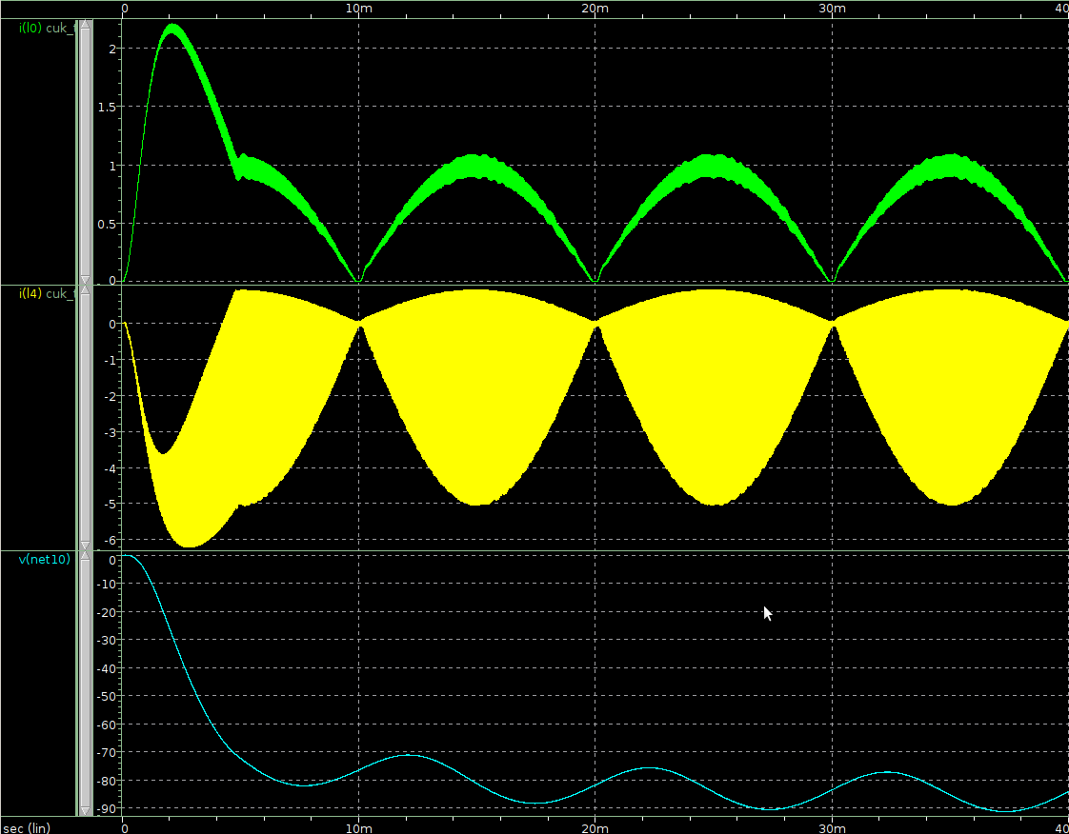
Appendix

Slide 7
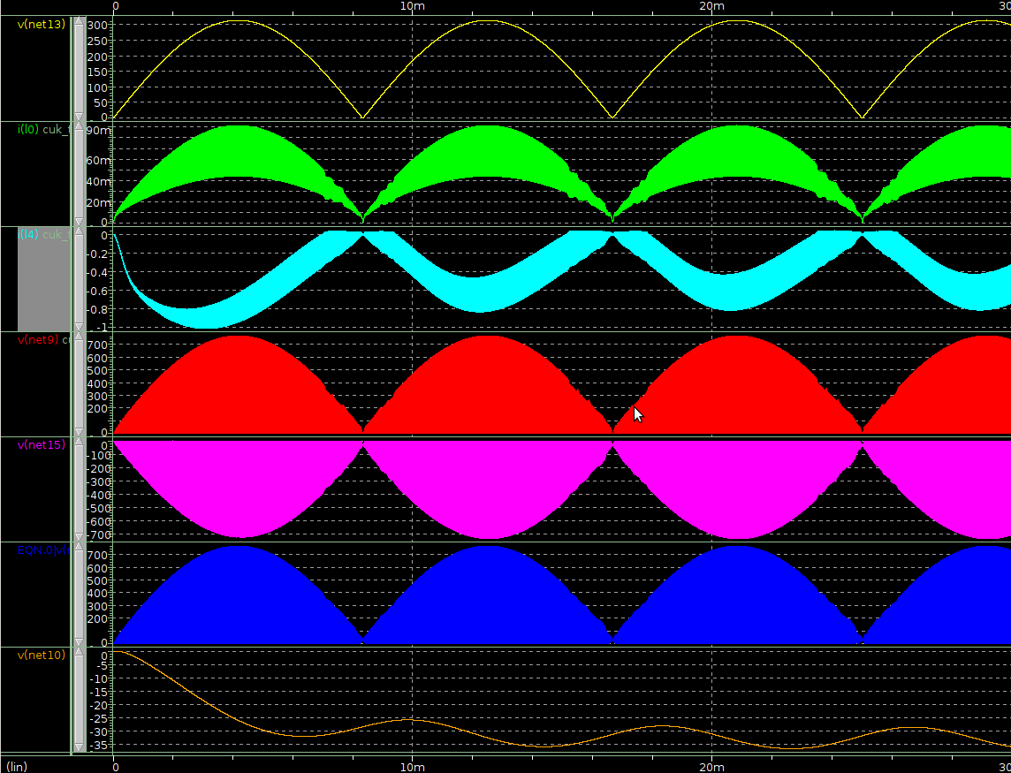
Discontinuous mode simulation
Vin
I_L1
I_L2
I_diode
V_pwm
V_a
V_b
V_cap
V_out

Slide 8




Discontinuous mode
Max Input current :
Max Input current ripple :
Ripple per current :
Capacitor Voltage Stress :
Discontinuous mode is not based on steady-state oper-.
  Input current of discontinuous mode is less dependent than continuous mode

Slide 9



Perfect continuous mode
Max Input current :
Max Input current ripple :
Ripple per current :
Capacitor Voltage Stress :

Slide 10




2.By “The discontinuous-” paper
Max Input current :
Max Input current ripple :
Ripple per current :
Prerequisite :

Slide 11
Discontinuous mode
Max Input current :
Max Input current ripple :
Ripple per current :
Capacitor Voltage Stress :
  Input current is independent of output resistor mag

