Slide 1
Yoontaek
Cuk Converter Analysis

Slide 2
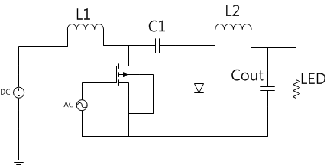
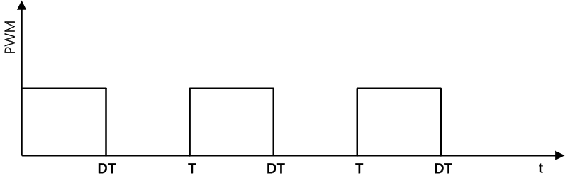
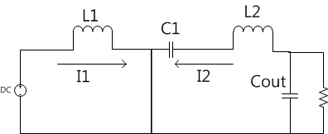
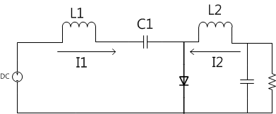
Cuk converter

Slide 3
Steady-state operation
+ VL1 -
+ VL2 -
Va
Vb
i1
i2
+ Vc -
Vg
+ Vout -

Slide 4
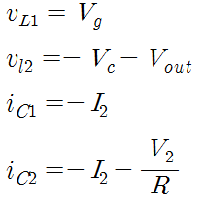
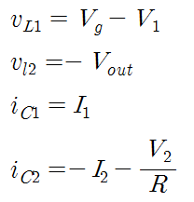
Steady-state operation
State1 : 0<t<DT
State2 : DT<t<T
ic1
ic2

Slide 5
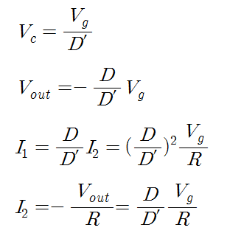
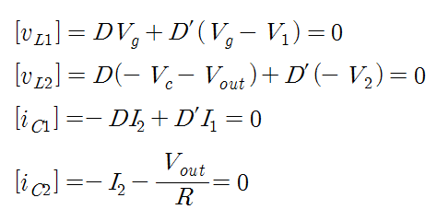

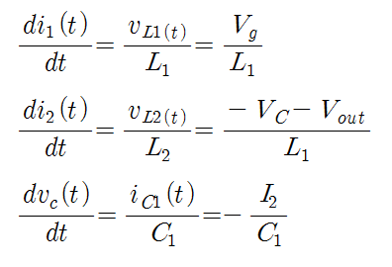
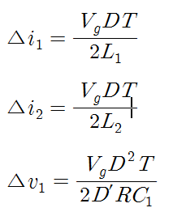
Steady-state operation
Average of each V and I
Variation of each V and I

Slide 6
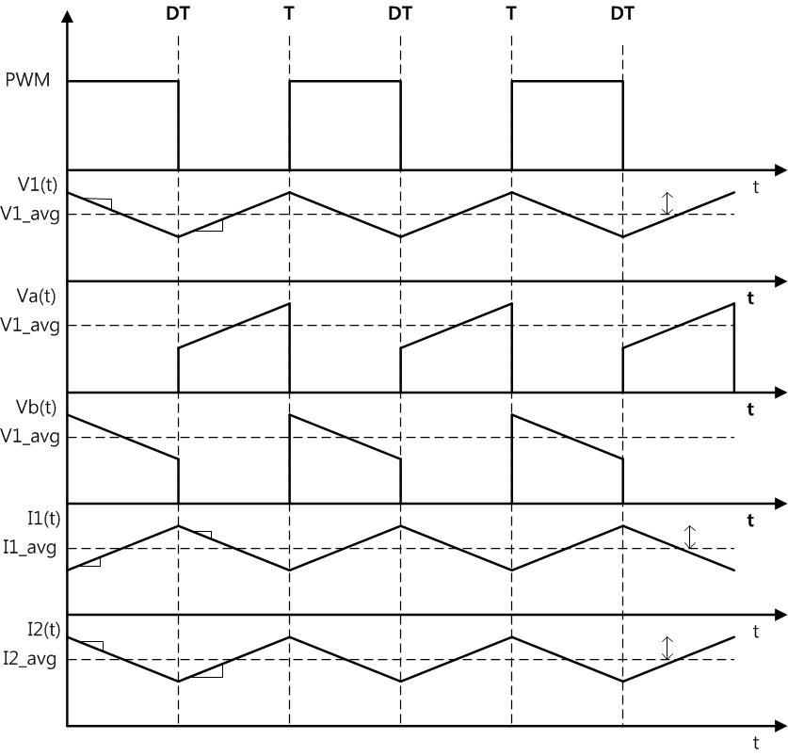
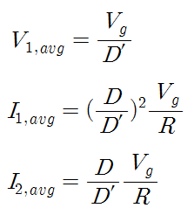



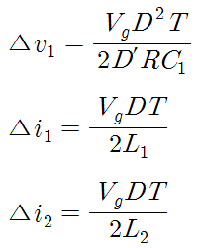






Steady-state operation

Slide 7
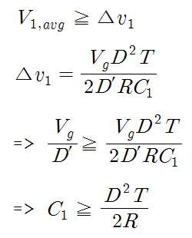
Continuous mode
Capacitor (Vc1) continuous mode
  If Capacitor average voltage is larger than voltage ripple, capacitor voltage continuous

Slide 8




Continuous mode
Max Input current :
Max Input current ripple :
Ripple per current :
Capacitor Voltage Stress :

Slide 9
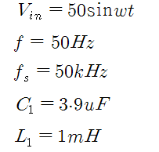
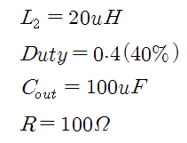
Continuous mode simulation
By “Design Criteria for Sepic and Cuk Converters as Power Factor Preregulators –”
  D.S.L simonetti, J. Sebastian
Following characteristics

Slide 10
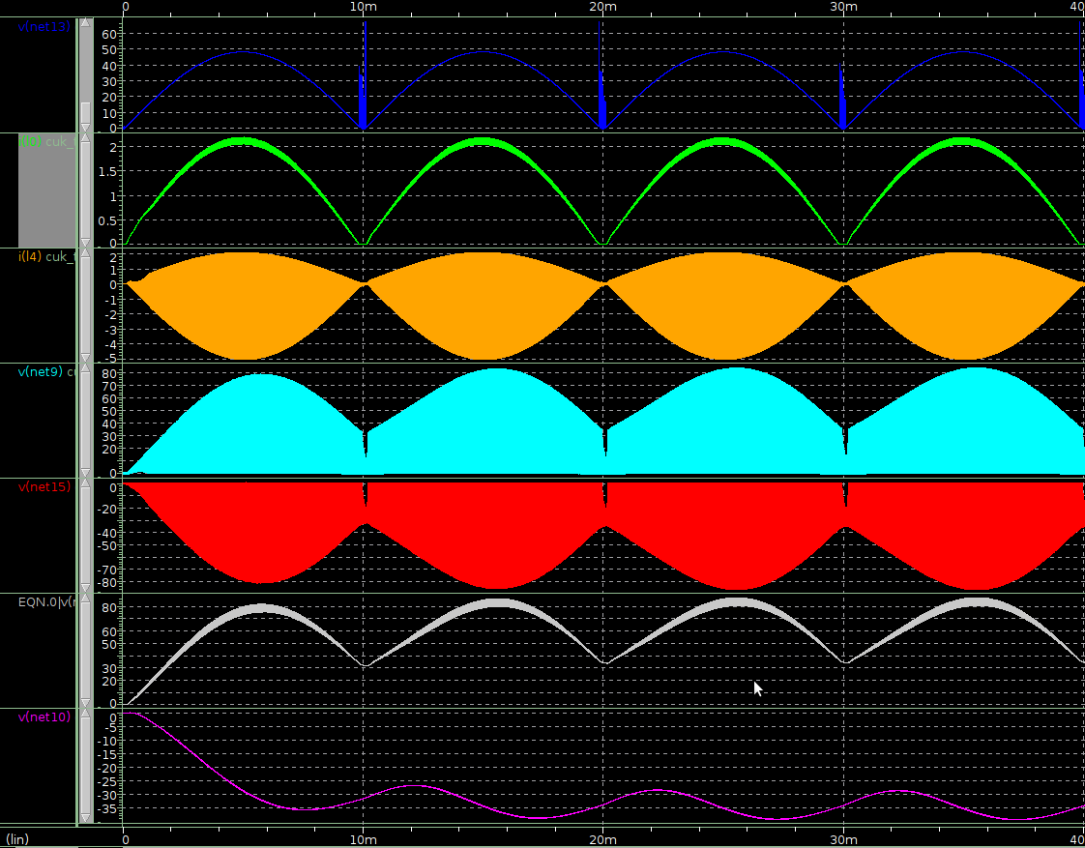
Continuous mode simulation1
Vin
I_L1
I_L2
V_a
V_b
V_cap
V_output

Slide 11
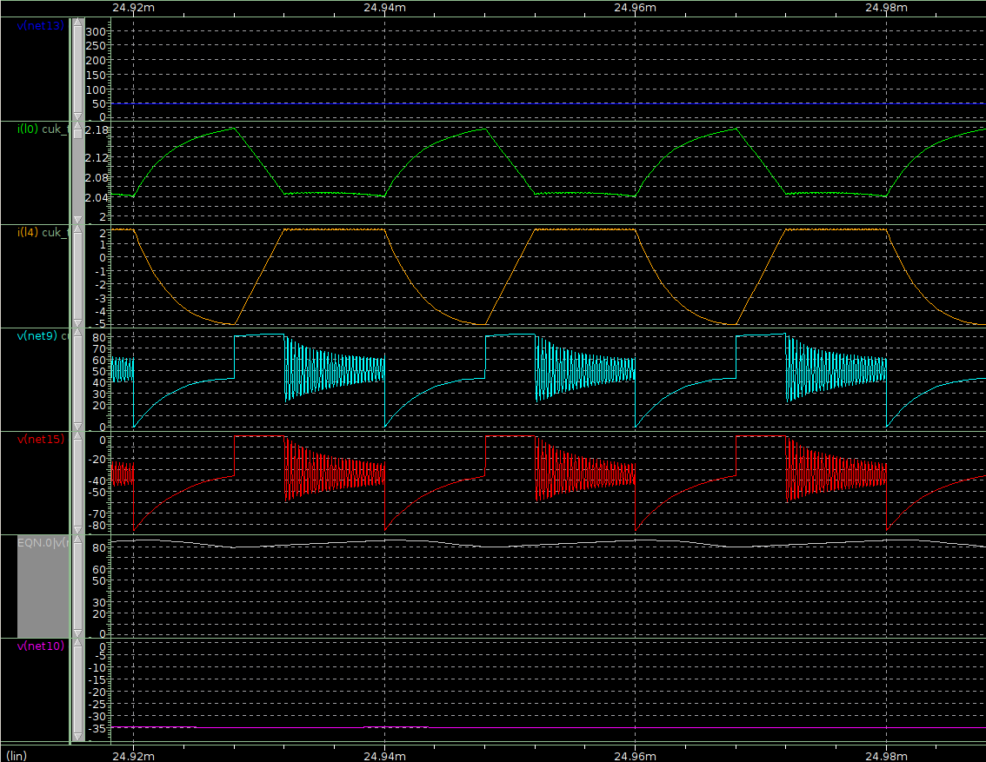
Continuous mode simulation1
Vin
I_L1
I_L2
V_a
V_b
V_cap
V_output

Slide 12
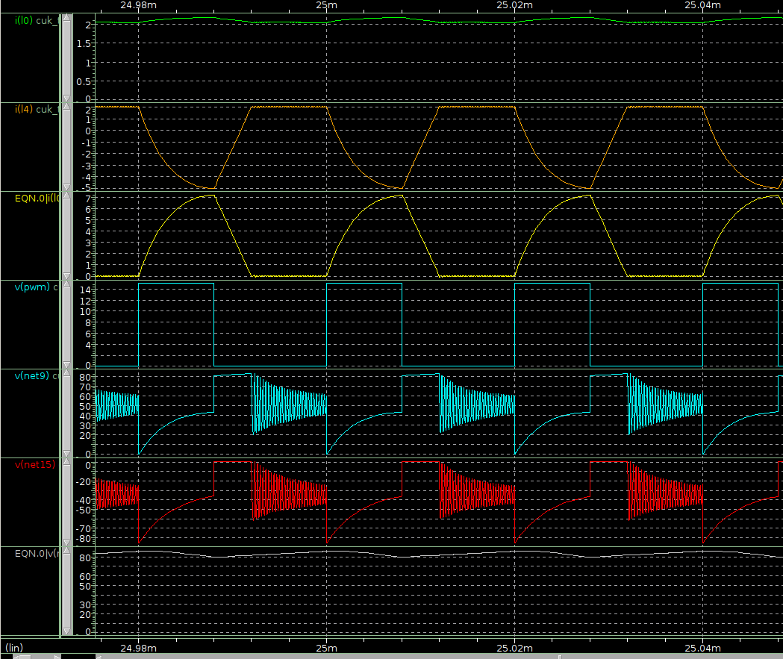
Continuous mode simulation1
I_L1
I_L2
I_diode
V_pwm
V_a
V_b
V_cap

Slide 13
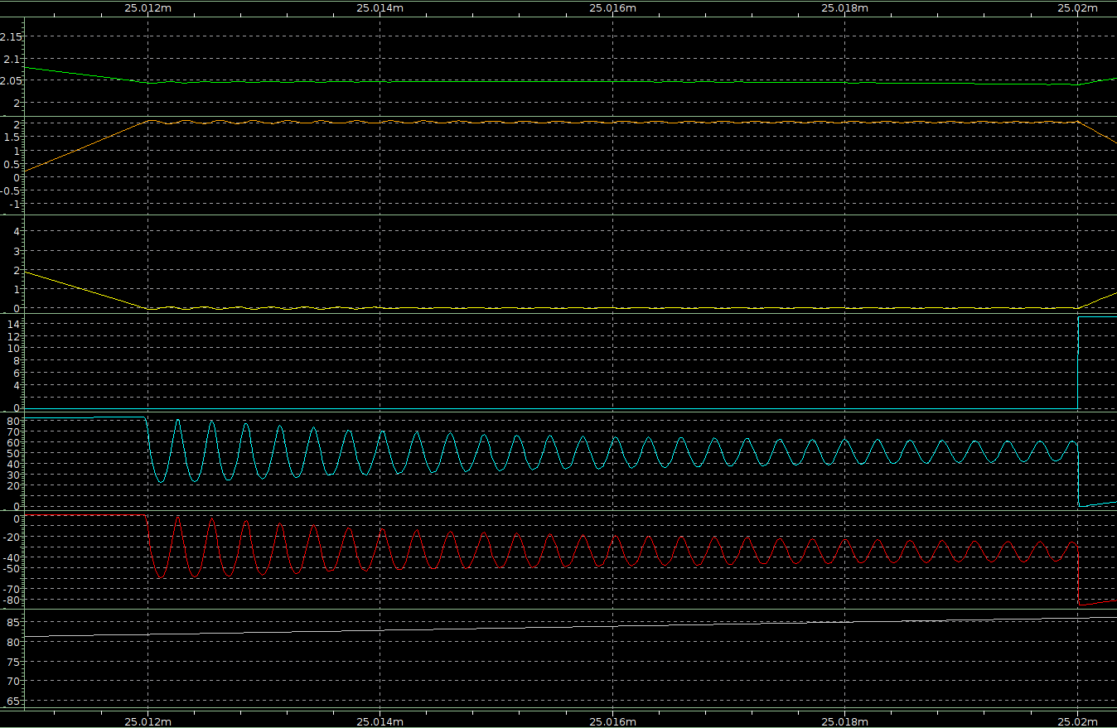
Continuous mode simulation1
I_L1
I_L2
I_diode
V_pwm
V_a
V_b
V_cap

Slide 14
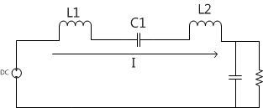

Causual analysis
But, if I1 + I2 <0
Just before I1 + I2 <0,
So, Va & Vb decrease after I1 + I2 <0

Slide 15
Continuous mode simulation2
For reducing I_L2 ripple,
  Increasing size of Inductor 2
L2 size : 20uF -> 150uF
Only L2 size is changed

Slide 16
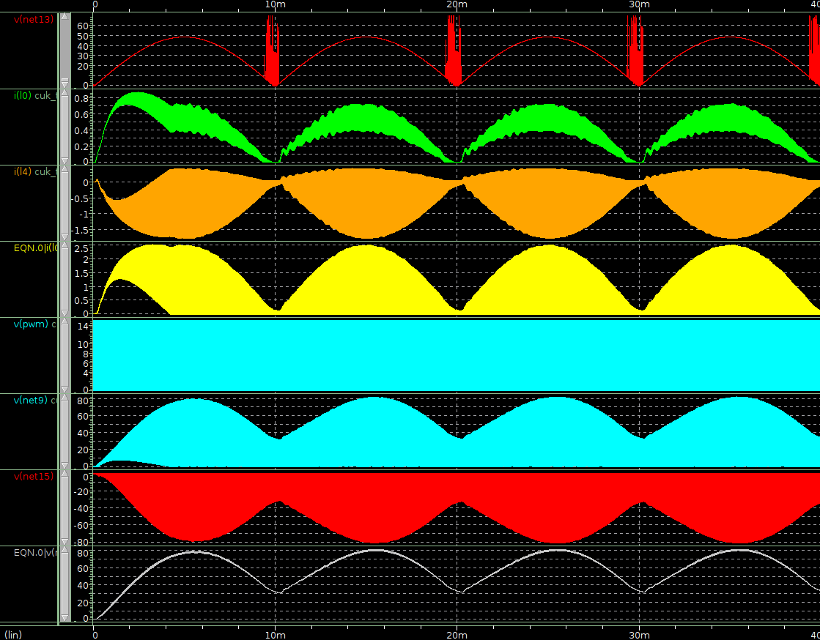
Continuous mode simulation2
Vin
I_L1
I_L2
I_diode
V_pwm
V_a
V_b
V_cap

Slide 17
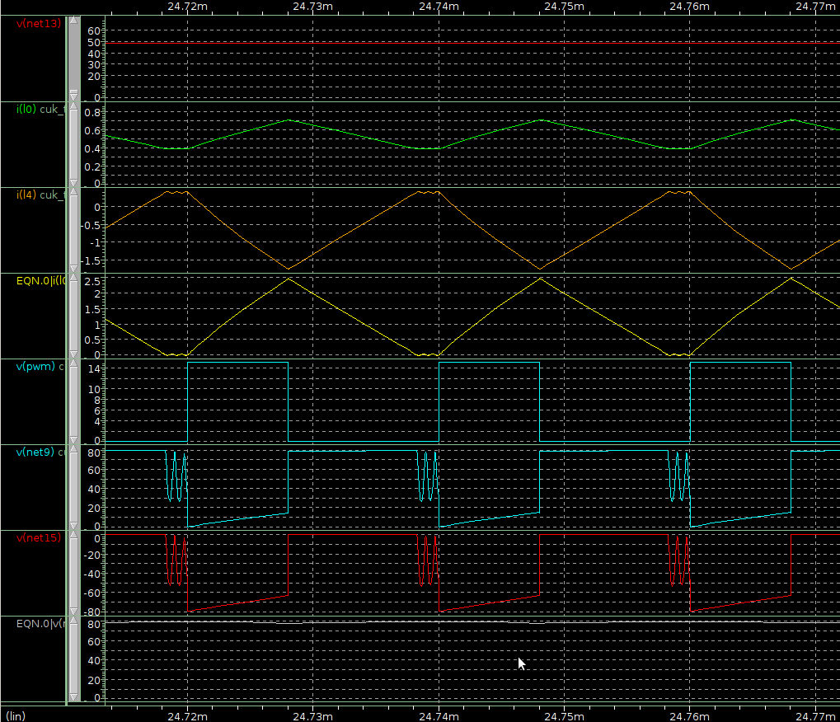
Continuous mode simulation2
Vin
I_L1
I_L2
I_diode
V_pwm
V_a
V_b
V_cap

Slide 18
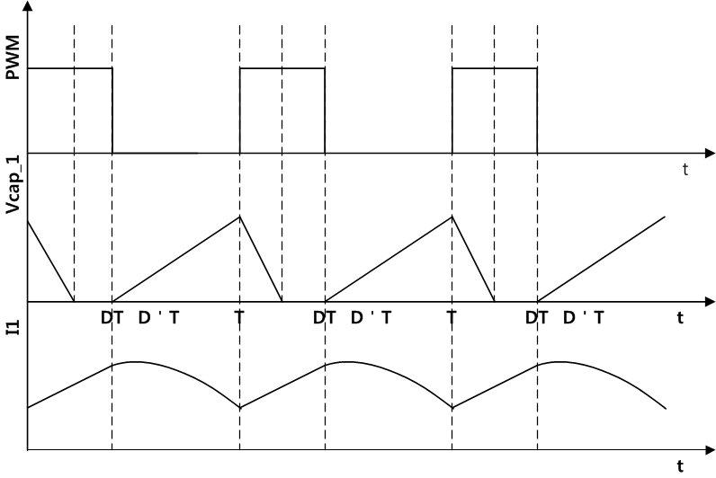
Discontinuous mode
Capacitor voltage discontinuous
When switch turns on, current variation is smooth

Slide 19



Discontinuous mode
Max Input current :
Max Input current ripple :
Ripple per current :
Capacitor Voltage Stress :

Slide 20
Discontinuous mode simulation
By “Power-Factor Correction Using Cuk Converter in Discontinuous-Capacitor-Voltage-”
  Bo-Tao Lin and Yim-shu Lee
Following characteristics

Slide 21
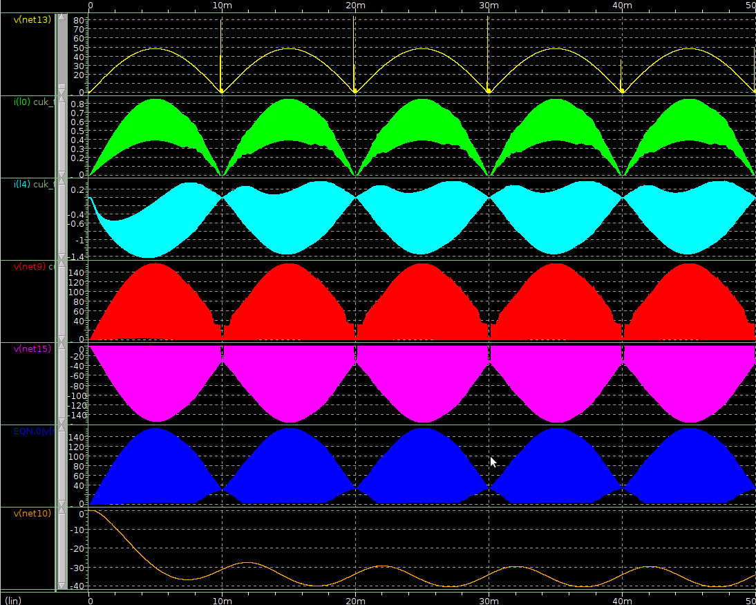
Discontinuous mode simulation
Vin
I_L1
I_L2
V_a
V_b
V_cap
V_output

Slide 22
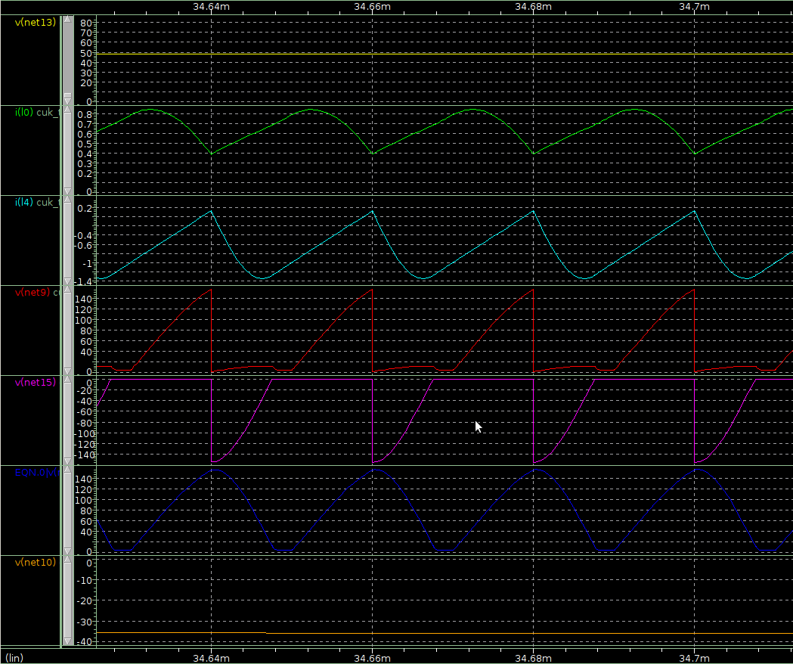
Discontinuous mode simulation
Vin
I_L1
I_L2
V_a
V_b
V_cap
V_output

